Slide 1
TRAVEL AND TOURISM MANAGEMENT SYSTEM
GROUP MEMBERS:
1.Asit Joshi(0827CS201045)
2.Ayush Choudhary(0827CS201052)
3.Deepakshi Choudhary(0827CS201064)
4.Deependra Singh Parihar(0827CS201065)
Submitted to Department of Computer Science

Slide 2
Project Presentation Outline
2
Abstract
Introduction
Problem Statement
Survey of Existing Systems
Project Objectives
Requirement Analysis
Solution Proposed
Models and Diagrams
The implementation
Testing
The Outcome discussion
Conclusions and Limitations

Slide 3
Abstract
3
This project “TRAVEL AND TOURISM MANAGEMENT SYSTEM” is used to automate all process of the travel and tourism, which deals with creation, booking and confirmation and user details.
The admin can add packages to the website and hotels by a tour page. Then the users can sign in and book each project, they can be confirmed by the admin in their manage booking page.
It is one of the easiest platform for all travelers which can be easily booked and know the all details.

Slide 4
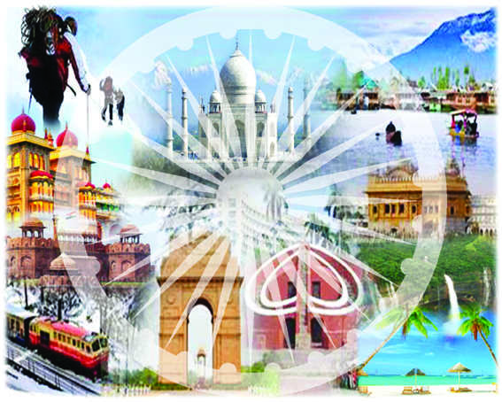
Introduction
4
Tourism is the largest and fastest-growing industry across the world. It gives the opportunity for people to understand the culture, civilization, and religious aspects of a country.
Travel and tourism management system is used to book a tour from anywhere in the world by a single dynamic website which will help the user to know all about the places and tour details in a single place.
Therefore, the motivation behind it is to provide solutions by developing a tourism awareness that is respectful with the environment and the local way of living of its inhabitants.

Slide 5
Problem Statement
5
India is a country where in a few days holiday, you can enjoy a lot. The problem is that we although have many websites but they offer different kinds of services. The customers are enjoying a lot but there is a lack of connection between travel agency and customers and hence we are establishing that relationship by booking, managing and confirming the packages.

Slide 6



Survey of Existing Systems
6
There are many systems that are dedicated to provide services related to travel and tourism but most of them are costly and much difficult to deal with:
MAKE MY TRIP - Make My Trip is an Indian online travel company provides online travel services including airline tickets, domestic and international holiday packages, hotel reservations, rail, and bus tickets.
THOMAS COOK (INDIA) - They provide various planned trips in many places which include national and international packages.
YATRA - Yatra.com aims to be the one stop travel shop for India’s travelers.
INCREDIBLE INDIA - The biggest advantage that India has from the perspective of tourism is its diversity. Very few countries in the world have this eclectic fusion of the traditional and the modern, the historical and the contemporary, the mountains and the seas, the deserts and the forests.

Slide 7

Survey of Existing Systems
6
Advantages:
This company offers heritage tours, cultural tours, educational tours, MICE, and special interest tours.
The services they offer include pick up and drop, multilingual guide services, accommodation, transportation, transfers, sightseeing trips, and also arrange tickets for special events on request.
Make My Trip route planner provides all the basic required information on more than 10 lakhs (1 million) routes in India. Make My Trip also offer metro train tickets for Hyderabad Metro.

Slide 8

Survey of Existing Systems
6
Disadvantages:
There should be all type of hotels for the user to select i.e. affordable hotels should also be available for bookings. So that the traveller gets all the possible options.
They can charge commission on every sale. This can range between 10-20 percent of the gross cost. There may be restrictive terms and conditions imposed by OTAs such as guest cancellation and automatic room reselling policies.
The main issue is not the cost but options, this site provide us budget option too but the starting budget is upto 30,000 and which is very costly for a middle class person who wishes to plan a holiday trip.

Slide 9
Objectives
7
The objective is to offer a variety of travel services and packages so that may fulfill the needs of the customers.
The purpose is to develop a system using which one can perform all the operations related to travelling.
It is a easiest platform for all travelers which can be easily booked and know the all details and management system organize things in well-designed manner and to make strong relationship with customers so that they can enjoy the holiday of their dreams.
Our project is just an initiative. It will be made to more further and developed work of art.

Slide 10
Requirement Analysis
8
Functional Requirements:
Gives accurate information and up to date information about the location and packages.
It minimizes the documentation related work.
Traveler's details will be preserved for any future booking or enquiry.
Booking confirmation and payment and other facilities will be provided at one place.
Website will provide a platform that will assist tourist towards information of various tourist locations.

Slide 11
Requirement Analysis
8
Non Functional Requirements:
The application should be easily accessible and should be reliable.
The application should load quickly.
The users data should be secured.
The application should be portable so that it is easily accessible.
Should be available 24 x 7.

Slide 12
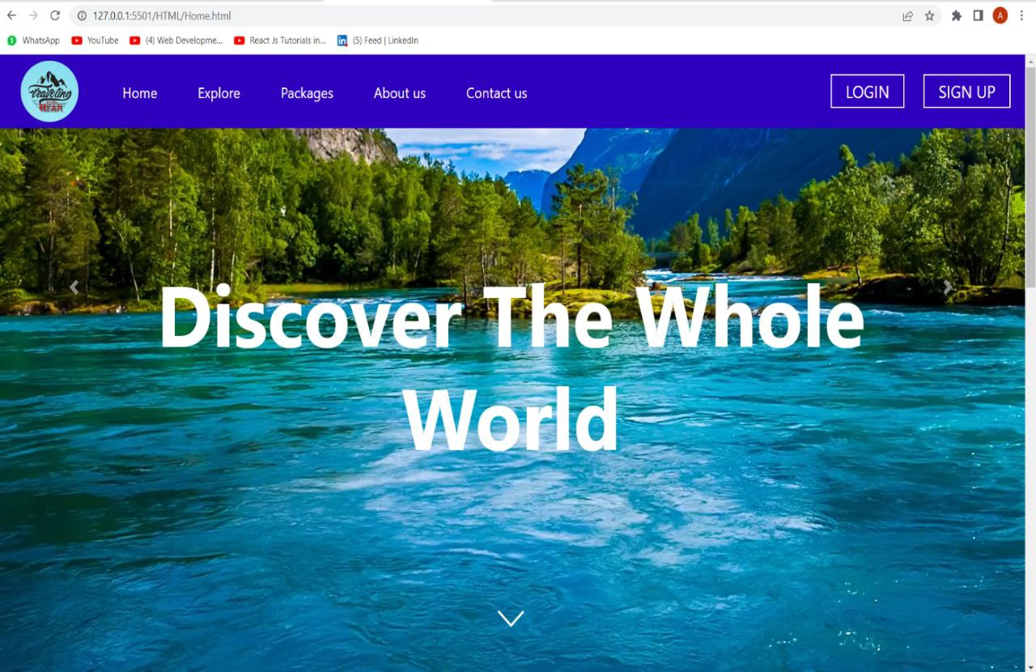
Solution proposed
9
Technology Stack:
XAMPP Server
HTML
CSS
JavaScript
PHP5.2.0
MySQL

Slide 13
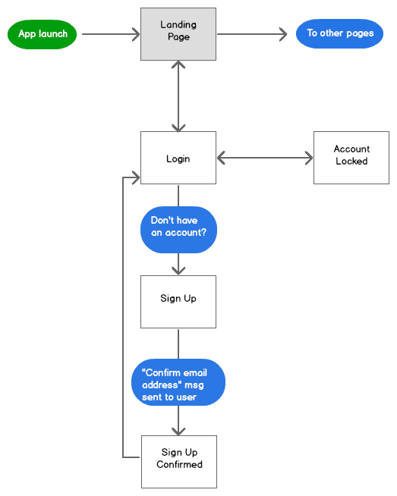
Solution proposed
9
The method/technique applied for development of project

Slide 14
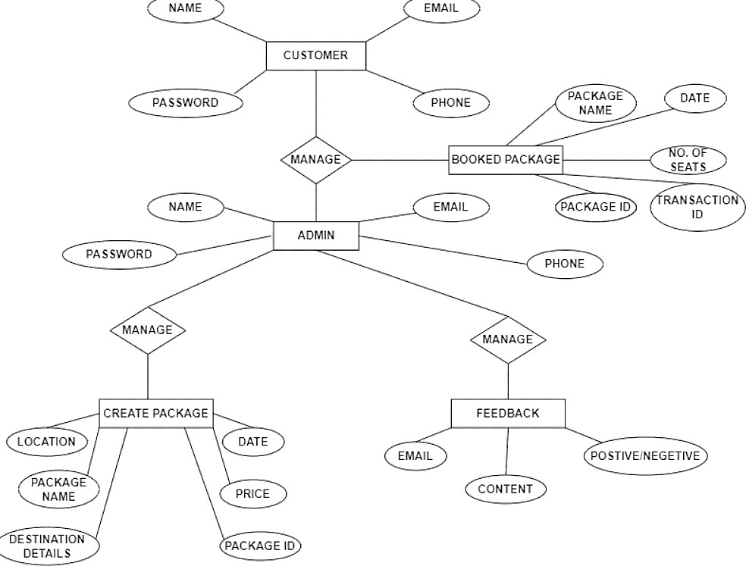
Models/Diagrams
10
ER Diagram

Slide 15
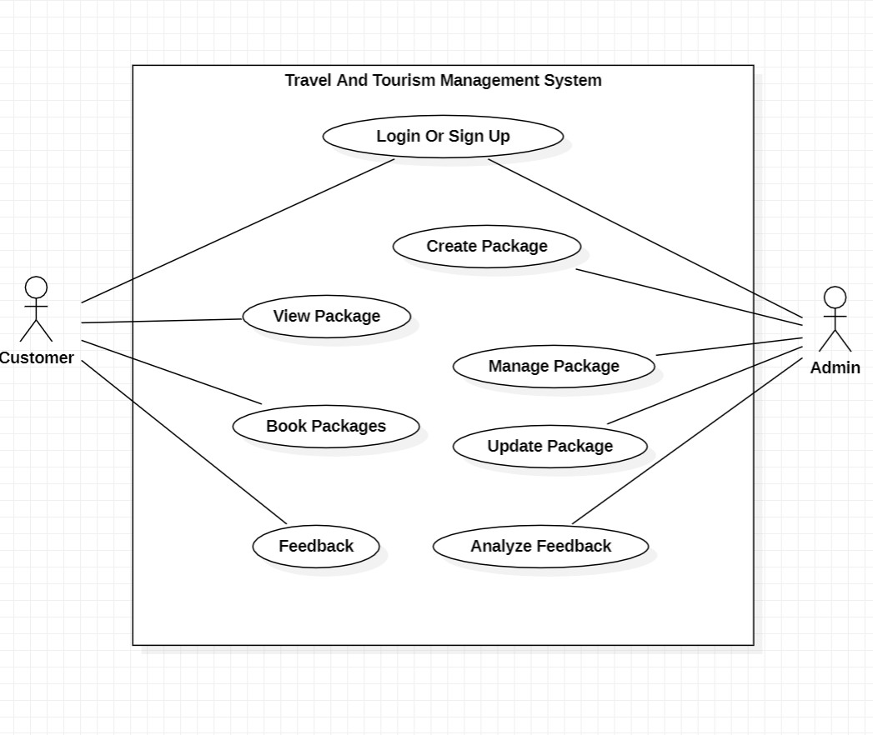
Models/Diagrams
10
Use Case Diagram

Slide 16
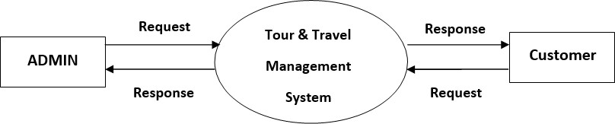
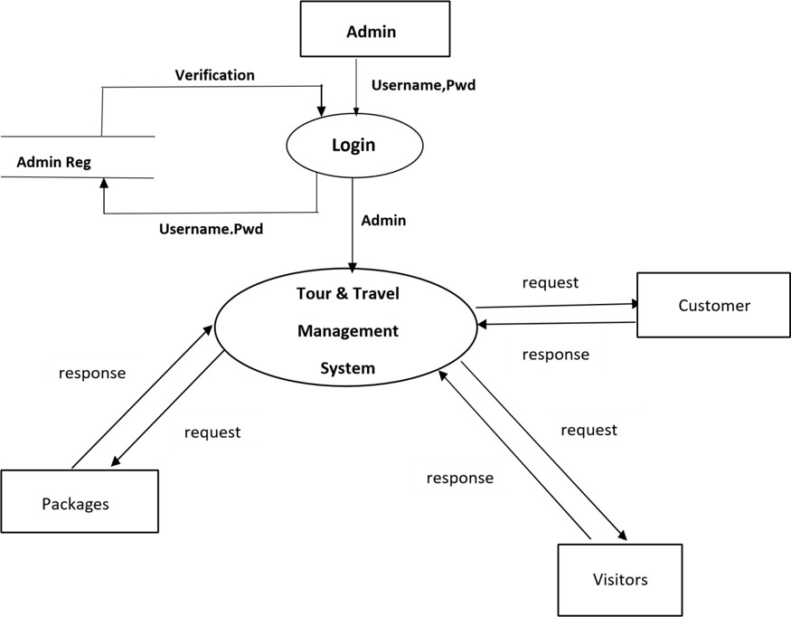
Models/Diagrams
10
DFD (Level 0) Admin Diagram
DFD (Level 1) Admin Diagram

Slide 17
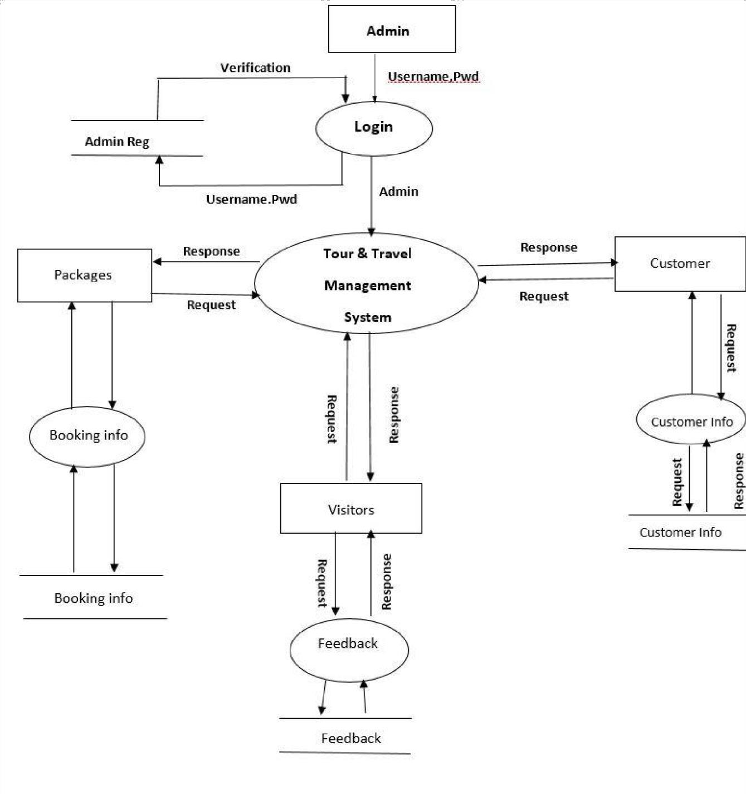
Models/Diagrams
10
DFD (Level 2) Admin Diagram

Slide 18
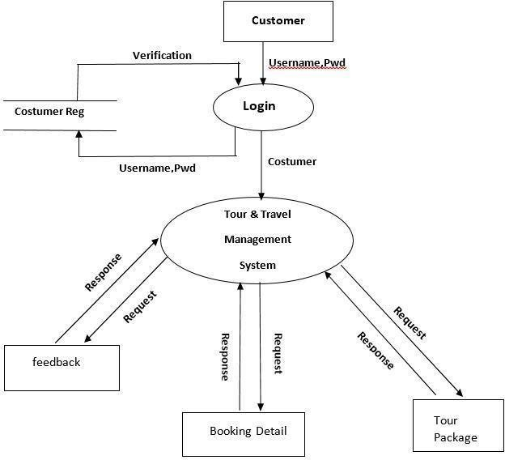
Models/Diagrams
10
DFD (Level 1) Customer Diagram

Slide 19
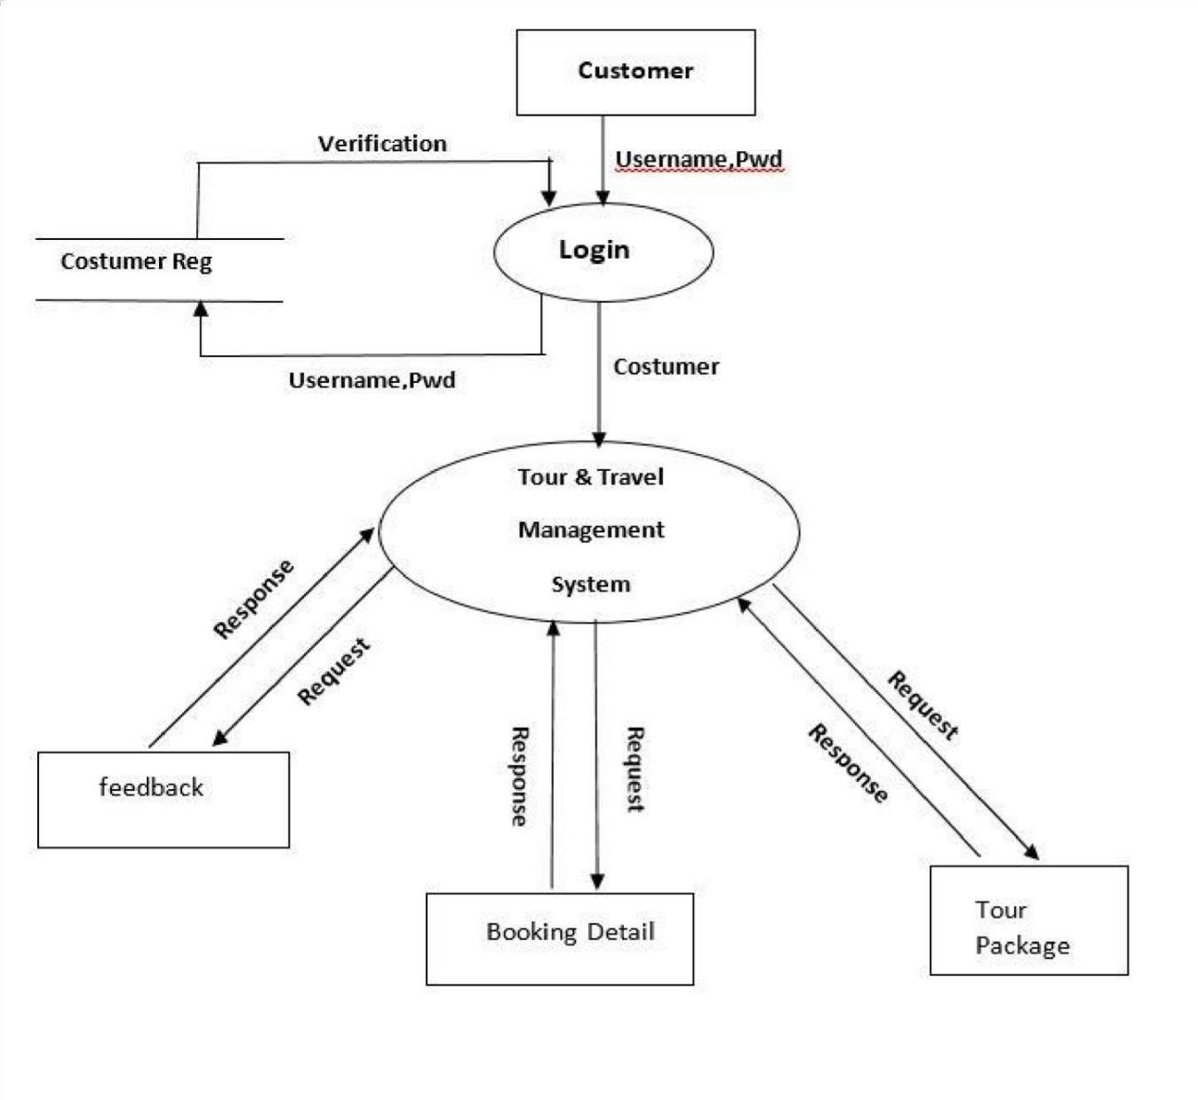
Models/Diagrams
10
DFD (Level 2) Customer Diagram

Slide 20
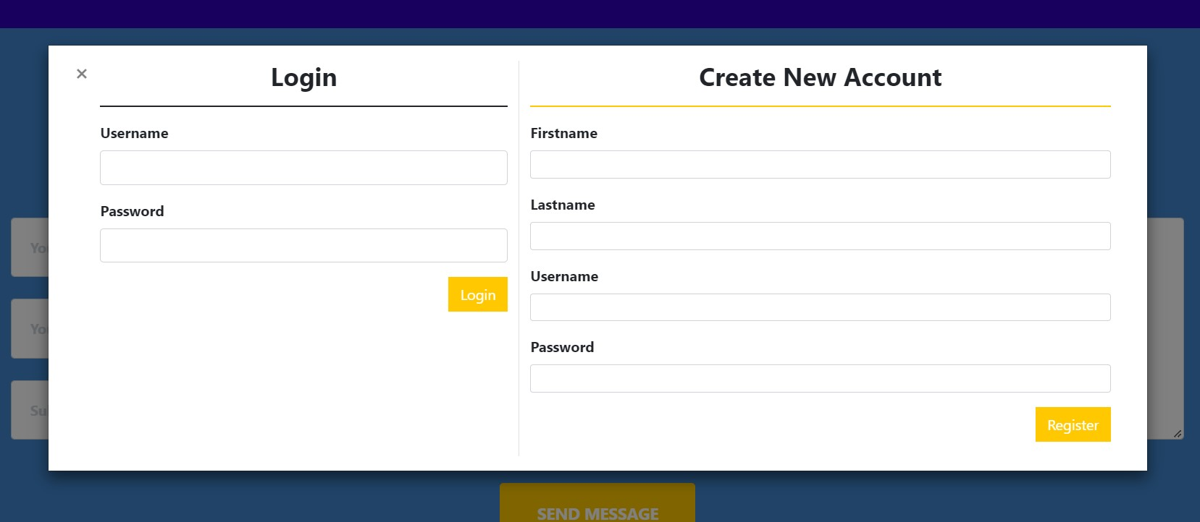
Implementation
11
Login and Sign up page

Slide 21
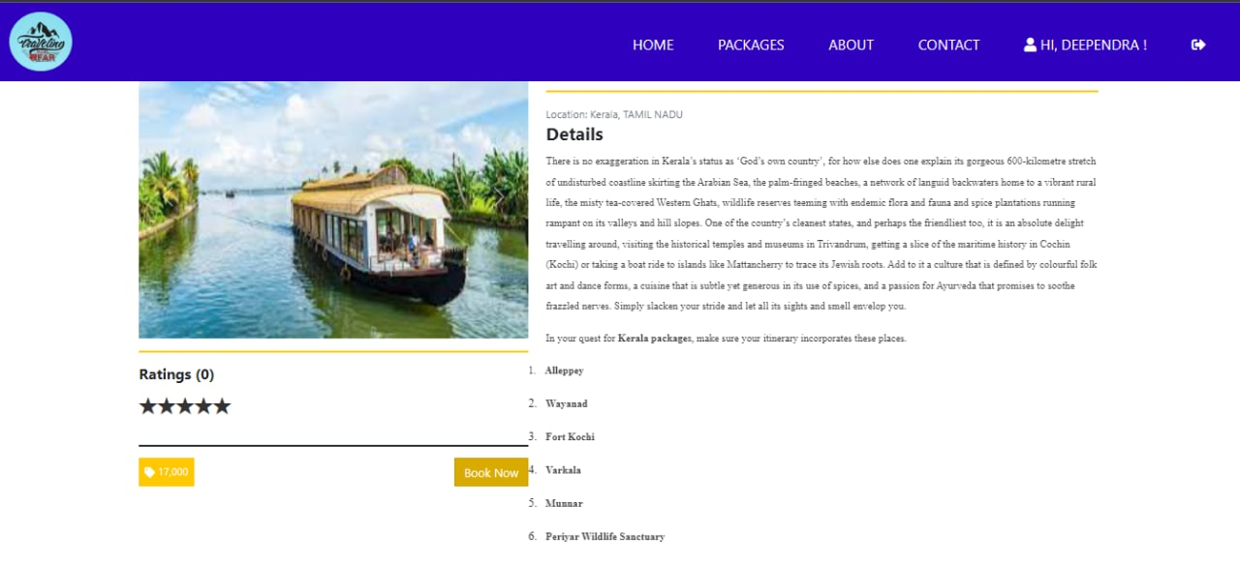
Implementation
11
Package Details Page

Slide 22
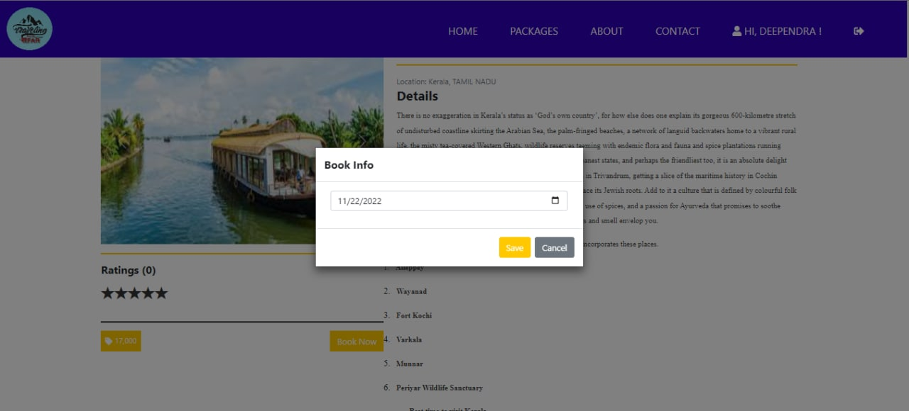
Implementation
11
Booking Info Page

Slide 23
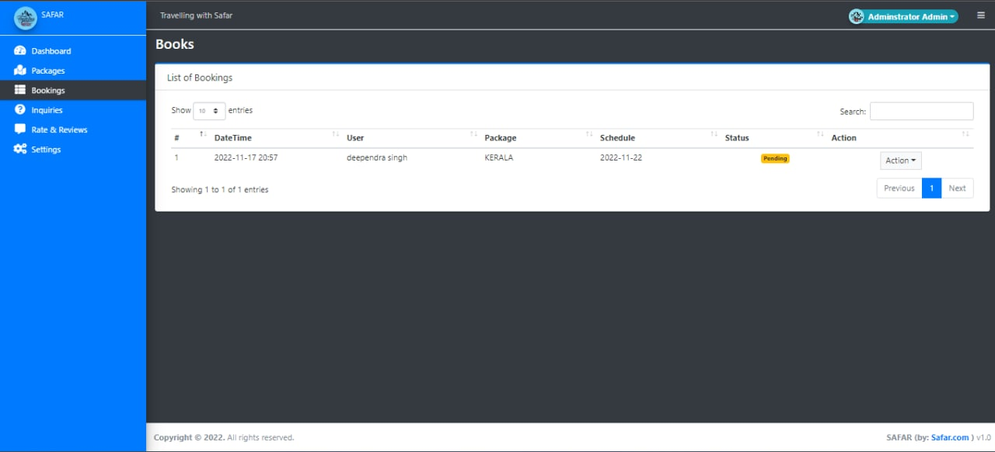
Implementation
11
Package pending Page

Slide 24
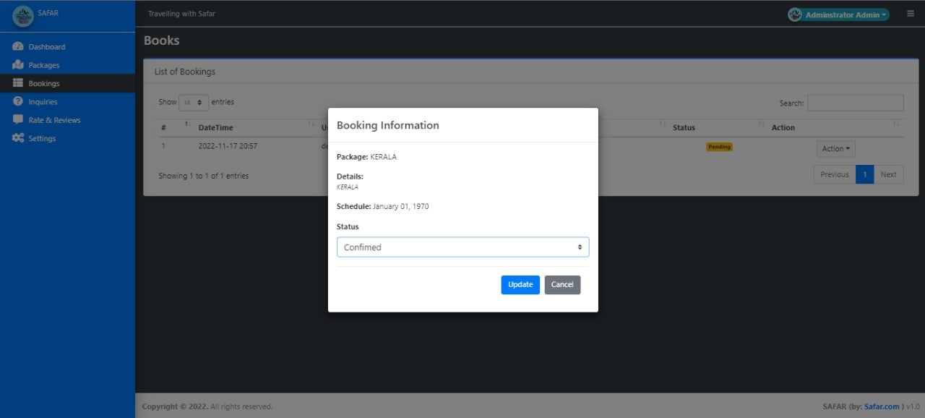
Implementation
11
Booking Confirmation Page

Slide 25
Testing/Test Cases
12
Test Case 1:
Test Case ID | TC001
Test Case Summary | Invalid Login Credentials Problem. Initially the login system was accepting invalid usernames (First name, Last name) it was accepting numbers in place of names so we find and dealt with it during the testing phase of the program.
Test Procedure | By using JavaScript validation system, we solved this problem of invalid login credentials.
Expected Result | First name and last name must be names and have a definite length.
Actual Result | First and last name must be names having minimum length of 3 letters and maximum 50. Email address provided should also be in valid form for registering to the portal.
Status | PASS

Slide 26
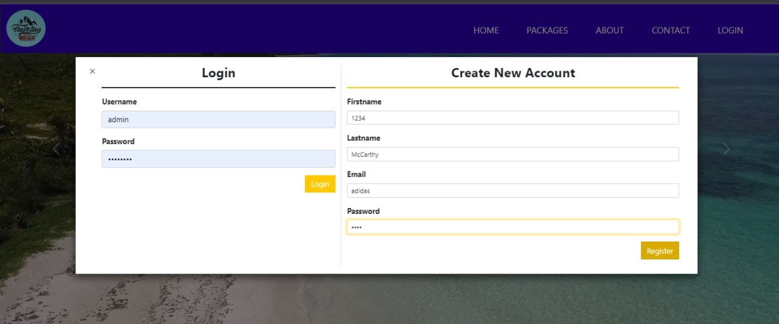
Testing/Test Cases
12
Test Case 1 Output:

Slide 27
Testing/Test Cases
12
Test Case 2:
Test Case ID | TC002
Test Case Summary | While creating new packages the uploaded photos of destination was not uploading to the portal.
Test Procedure | We created A new folder for the photos to be stored and the relative path was stored in the database.
Expected Result | Photos should be loading in webpage and showing to users after creation of any new package.
Actual Result | Photos were actually loading in the webpage and can be viewed by users.
Status | PASS

Slide 28
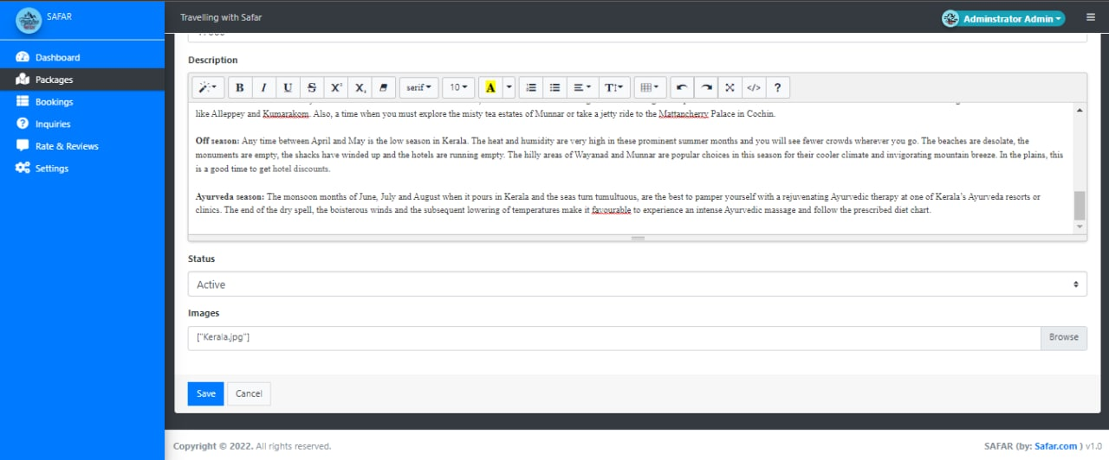
Testing/Test Cases
12
Test Case 2 Output:

Slide 29
The Outcome discussion
13
The output module of this system is a user-friendly window. The user enters their username and password for login and new users can complete their registration by providing required information.
If the username and password are valid, then the user can access all pages else the user is informed by a message showing an incorrect username/password.
The user then gets complete information about the various tourist places. The user views the best deals after entering the required data about the tour and can book their tour.
This system also included the feature to delete, update, display the user details from the database and review system for the user is also provided.

Slide 30
Conclusion and Limitation
14
Tourism is currently recognized as a global industry which is growing at a high rate like any other industry. Access to relevant and accurate information is at the heart of tourism. Here, the proposed project on Tourism Management System tries to bridge the gap by noting what a tourist perceives as relevant. Hence, the aim of this project entails the design and implementation of a platform that will assist tourists in gaining access to travel to various tourist locations.
One major limitation is there are already existing websites providing such facilities all over internet so it will be difficult to distinguish our website from such high competition that’s why our main focus will be our affordable packages that might attract costumers towards us. And as by doing this project we will also learn to implement out knowledge into real world application.

Slide 31
Acknowledgment
15
We would like to extend our heartfelt gratitude to our Computer science and engineering department for providing us with this great opportunity to work on this project .We would also like to express our sincere gratitude to Prof. Ronak Jain for his valuable guidance and kind supervision throughout the course of this project.

